Slide 1
So You are a DeMolay Now What?
Massachusetts DeMolay
Orientation Program

Slide 2
Orientation Agenda
History of DeMolay
The Degrees You Just Received
Get to Know Your Brothers
What do DeMolays Do?
Awards and Honors
Big Brother Program

Slide 3
History of DeMolay
Frank S. Land and Louis Lower
How DeMolay got its name
Ritual of the organization
How DeMolay grew

Slide 4
The Degrees You Just Received
Application
Interview
Voting Procedure

Slide 5
First Degree - Obligation

Slide 6
First Degree

Slide 7
First Degree

Slide 8
First Degree

Slide 9
First Degree

Slide 10
First Degree

Slide 11
First Degree

Slide 12
First Degree

Slide 13
First Degree
Grip
Step, Sign, and Token
Sign of Distress
Word of the Day

Slide 14
DeMolay Degree Obligation

Slide 15
DeMolay Degree
Password
Sign

Slide 16
During Prayers

Slide 17
Raps of the Gavel
One Rap - Seats Everyone and Calls the Chapter to Order
Two Raps - All Officers Rise
Three Raps - Everyone in Chapter Room Rises

Slide 18
Questions about the Degrees?

Slide 19
Activities

Slide 20
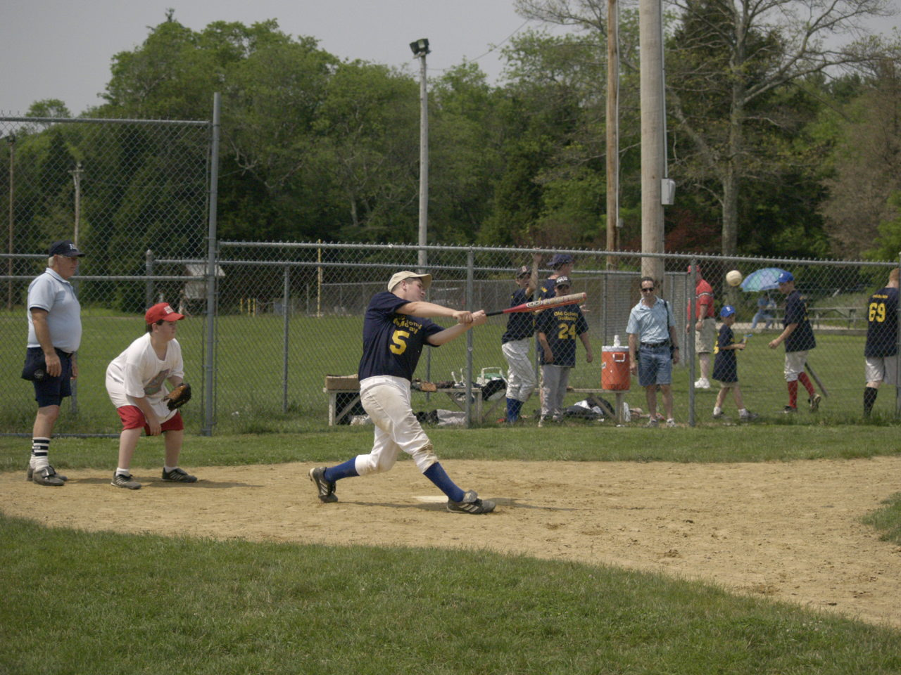

Slide 21
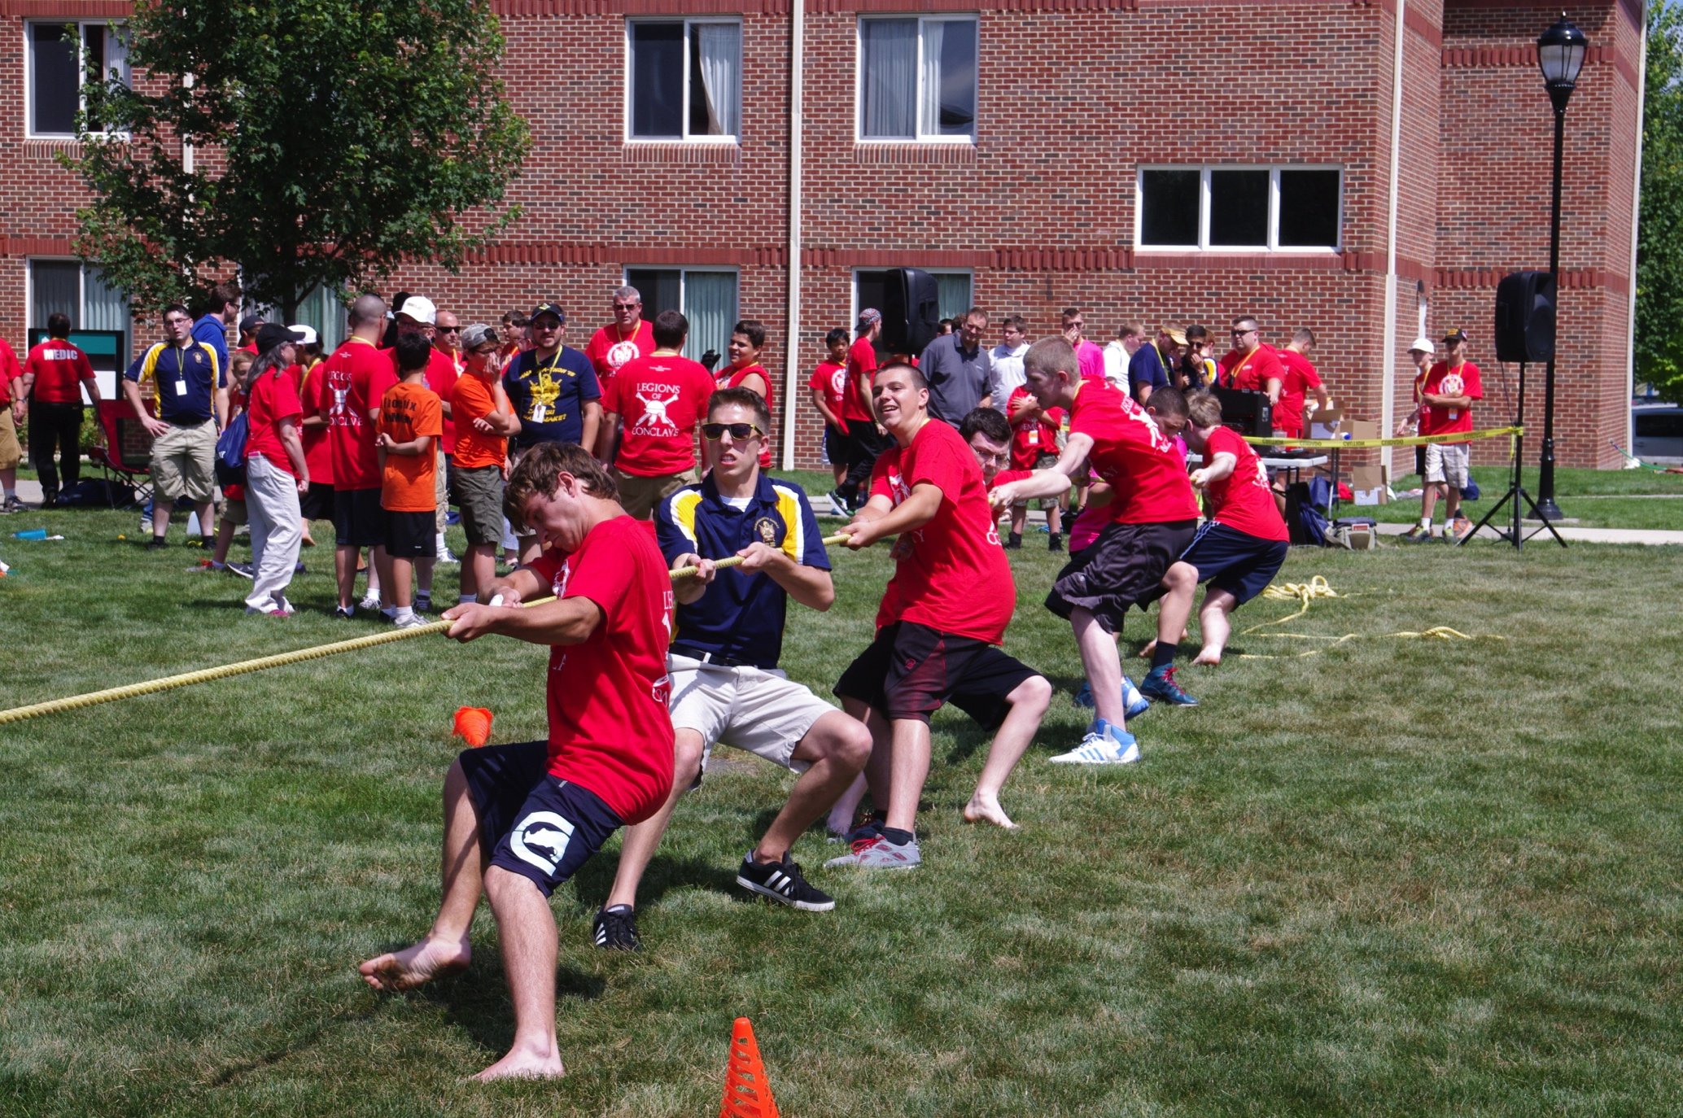

Slide 22
Activities

Slide 23
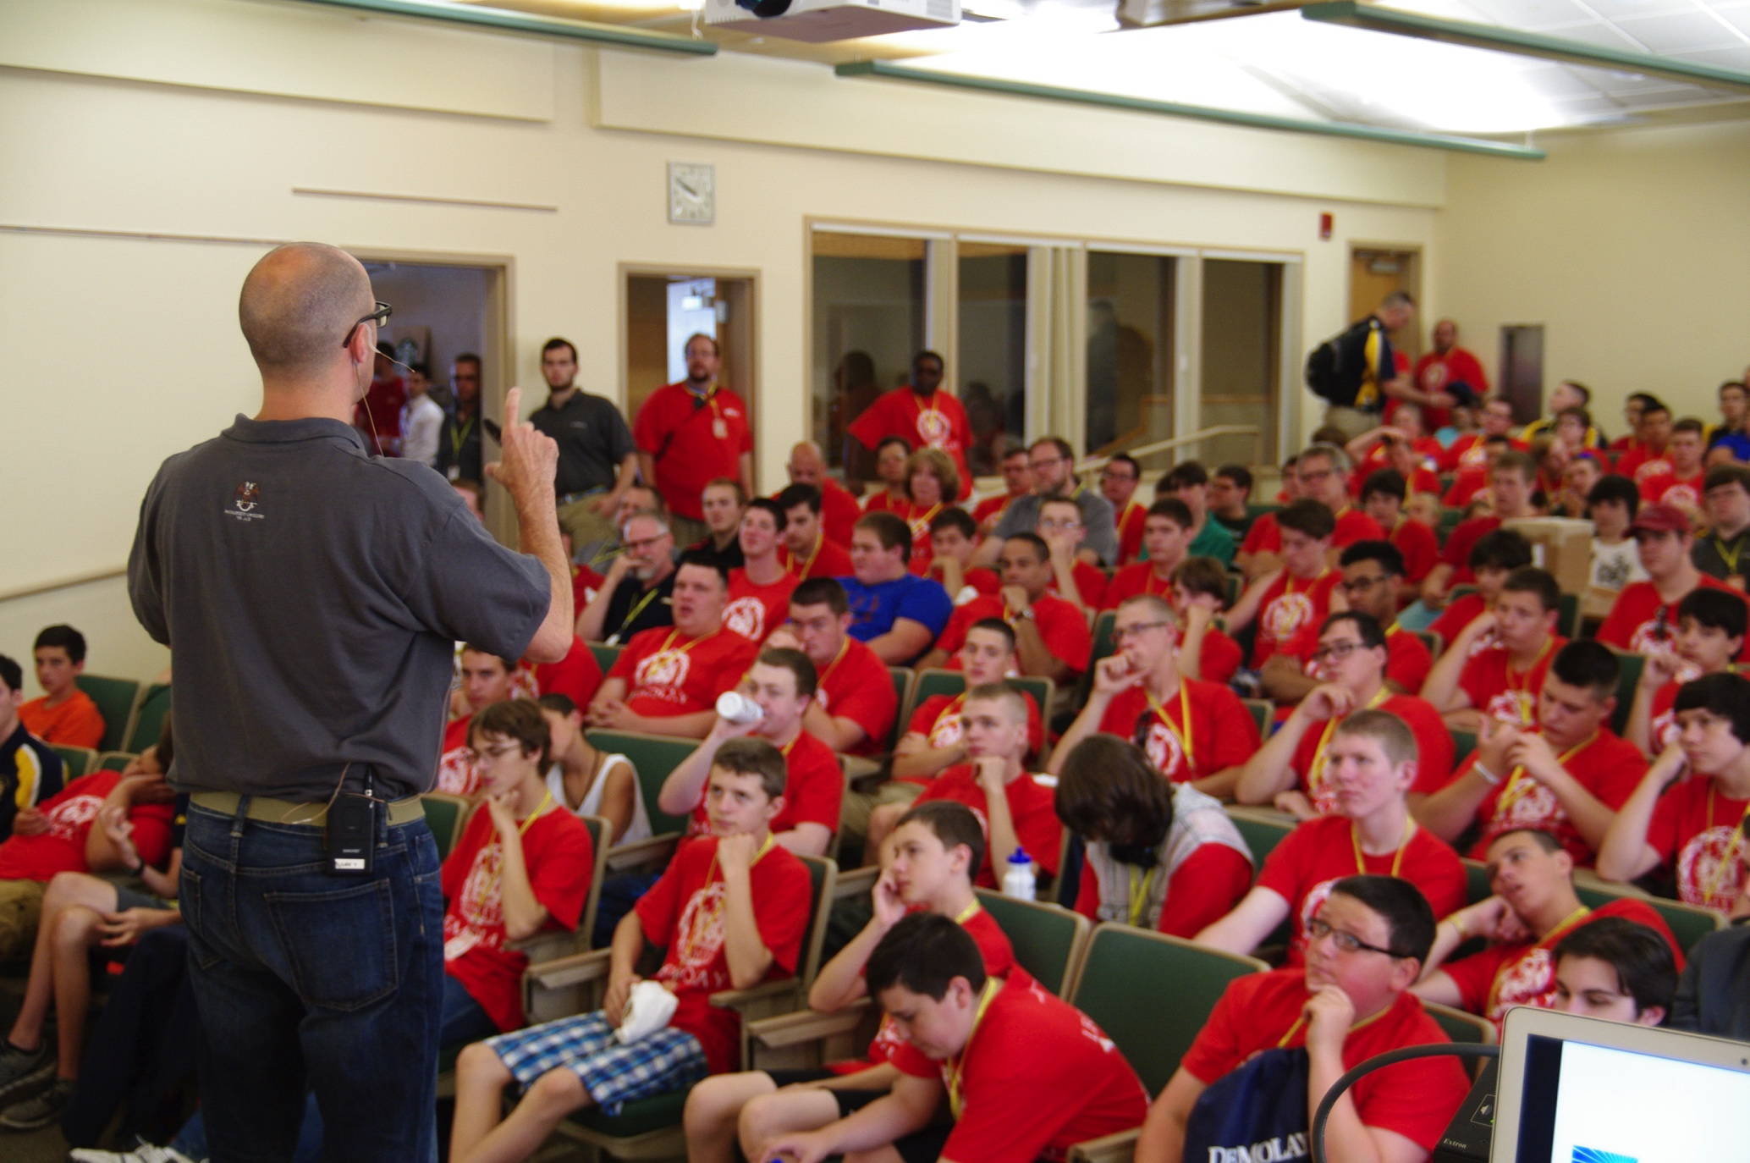

Slide 24
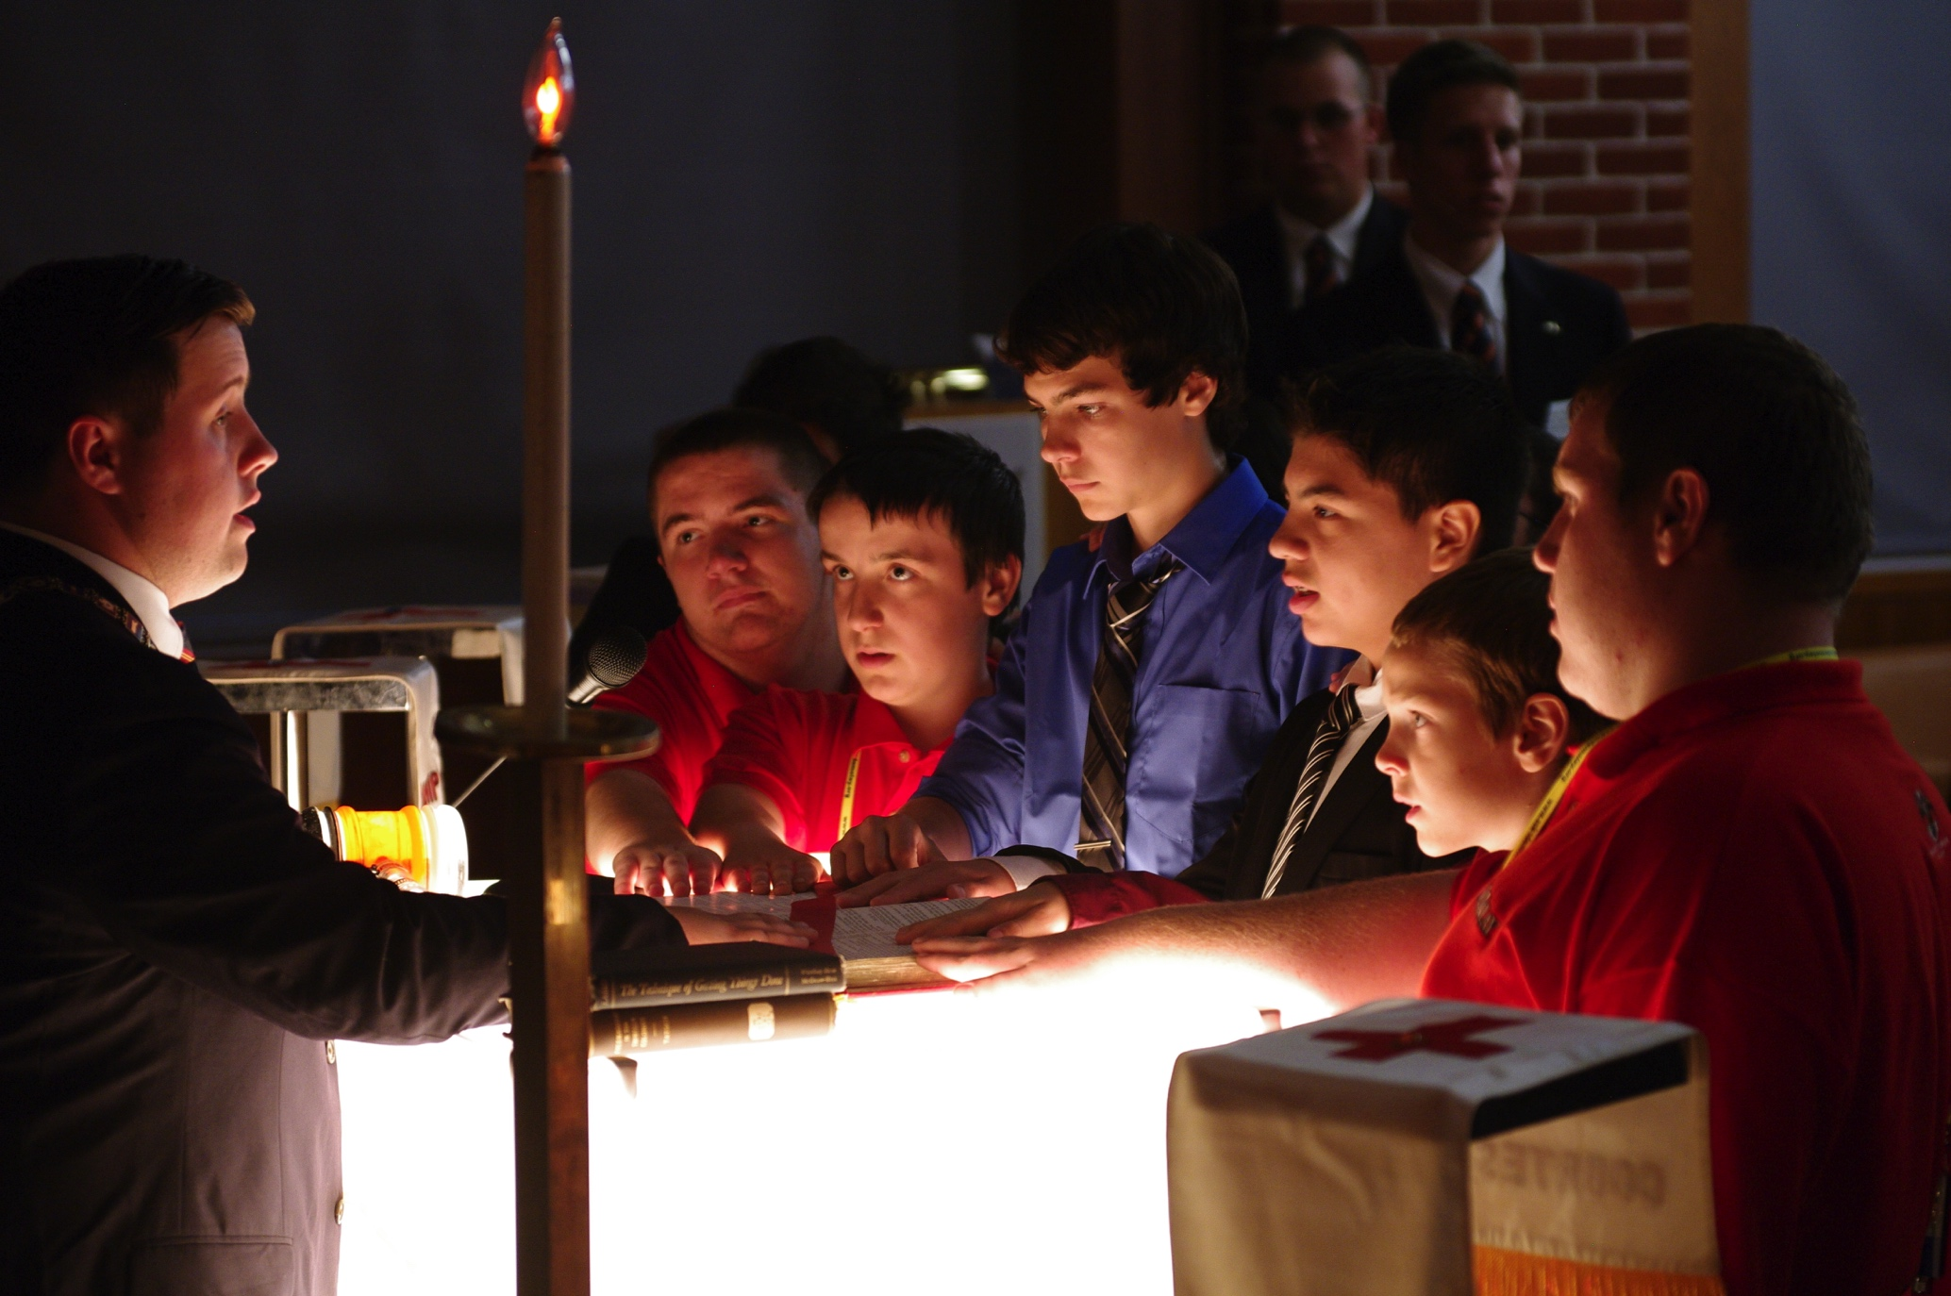

Slide 25
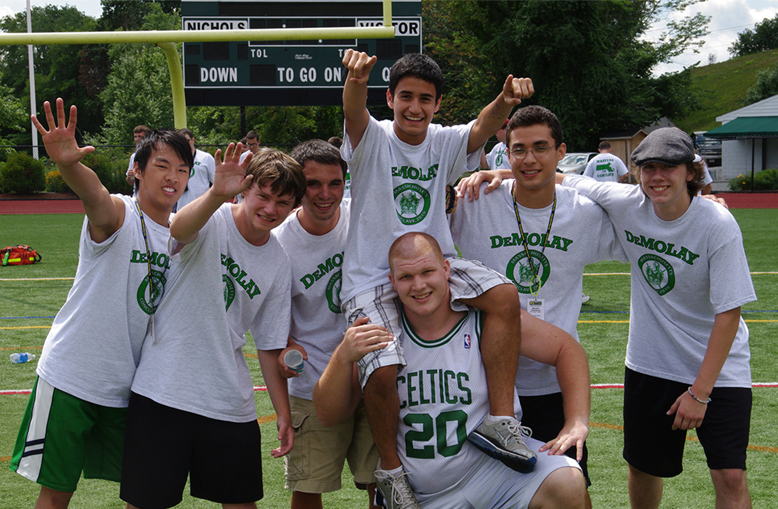

Slide 26
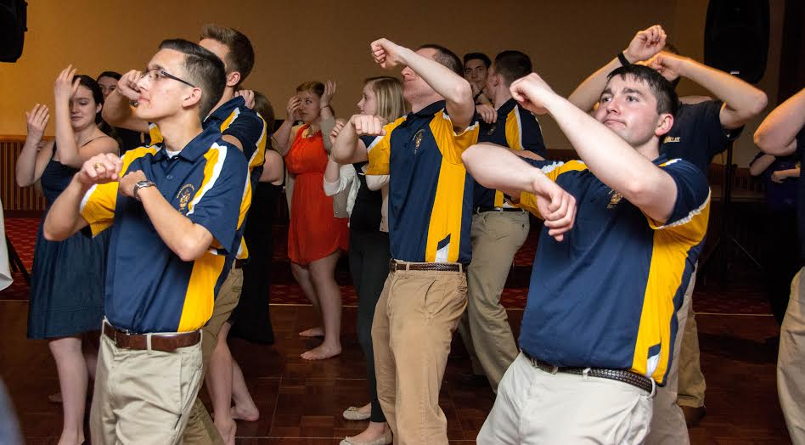

Slide 27
Awards

Slide 28
Membership Awards

Slide 29
Awards

Slide 30
Now What?
GET INVOLVED
Attend Meetings and Events
Become a Member on a Committee
Become an Officer in Your Chapter

Slide 31
Thank you for Coming
Good Luck in DeMolay

